Slide 1
Wednesday, January 18, 2017
Write In Your Agenda:
Write In Your Monitoring Log:
CW:
Learn more about Ecology by watching “Galapagos: Born of Fire.”
HW:
None.
Response to Warm-Up:
What do the letters in Ms. Nerg stand for?
You will need:
Pencil
Ms. Nerg notesheet.

Slide 2
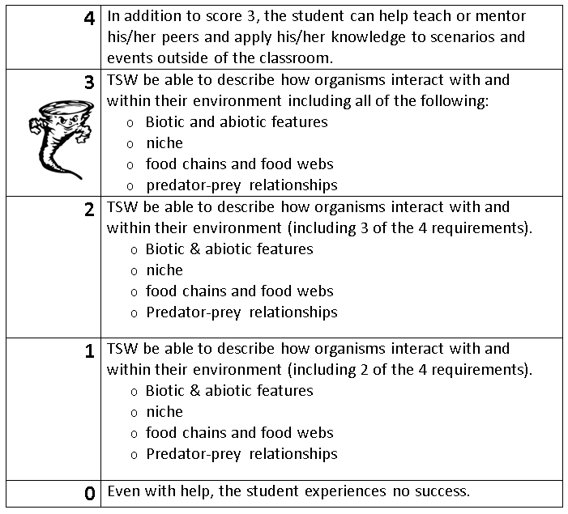
Learning Goal and Scale
TSW be able to describe how organisms interact with and within their environment (including biotic and abiotic features, niche, food chains & webs, and predator-prey relationships).

